Slide 1
BRIDGE
HYDRAULICS
Ramesh Pinjani
Sr Prof Bridges/IRICEN Pune

Slide 2
Lecture plan
1. Important definitions / Terminology
2. Methods of estimation of design discharge- sub structure code provisions(Para 4.3)
3. Working out Q50 for catchment area < 25 sqkm – RDSO report RBF-16
4. Sample calculations on Q50 estimation
5. Working out Q50 for catchment area 25 sqkm – 2500 sqkm – Flood estimation report ( A joint work of CWC,RDSO,IMD,MOT)

Slide 3
Lecture plan (Contd)
6.Sample calculations on Q50 estimation SUH concept( catchment 25-2500 sqkm)
7. Design of water ways – various provisions in sub structure code (Para-4.5)
8. Depth of scour various provisions in sub structure code (Para-4.6)
9. Sub structure code provisions on afflux, clearance, free board (Para 4.7,4.8,4.9)

Slide 4
Important definitions (para 2 0f sub structure code)
1. Design discharge Q:The estimated discharge for the design of the bridge and its appurtenances.
2. Afflux(h) : The rise in water level upstream of bridge as a result of obstruction to the natural flow caused by the construction of the bridge & its approaches
3. Free board (F): The vertical distance between the water level corresponding to design discharge (Q) including afflux(h) and the formation level of its approach bank / top level of guide bank
4. Clearance ( C ) : The vertical distance between the water level corresponding to design discharge Q including afflux and the point on the bridge super structure where the clearance is required to be measured

Slide 5
5. Depth of Scour: The depth of eroded bed of river measured from the water level for the discharge considered
6. Highest flood level (HFL): Highest water level known to have occurred
7. Low Water level(LWL) : water level generally obtained during dry weather
Important bridge: Those having
Linear water way >= 300m OR
Total water way >= 1000 sqm OR
Classified as important by CE/CBE depending upon consideration such as depth of water way, extent of river training works & maintenance problems

Slide 6
9. Major Bridge: Those having
Total water way >= 18 m OR
Clear opening of 12 m or more in any one span
10. Protection works: Works to protect the bridge and its approaches from damage of flood water
11. Training works: The works designed to guide and confine the flow of river

Slide 7
Relevance of Design discharge
It is required for proper and economical design, construction and maintenance of
  Bridge water way
  Foundations
  Protection works
Fixing / deciding Other parameters
  Afflux
  Free board &
  Vertical clearances

Slide 8
Estimation of Design discharge (Q) (Para 4.2 S.S.C)
Para 4.2.1 The estimation of design discharge for waterway shall preferably be based, wherever possible, on procedures evolved from actual hydro meteorological observations of the same or similar catchments.”
Para 4.2.2 The design discharge (Q) normally shall be computed flood with a probable recurrence interval of 50 years. However at the discretion of PCE/CBE:
a) Bridges where damage is likely to have severe consequences, may be designed with flood recurrence interval of more than 50 years
b) Bridges on less important lines or sidings may be designed for floods with a probable recurrence interval of less than 50 years

Slide 9
Method of Estimation of Design discharge
(Para 4.3 of substructure code )
Conceptually the methods are based on
a) From actual data (Para - 4.3.1)
b) Statistical methods (Para - 4.3.2)
c) Unit hydrograph (Para – 4.3.3)
d) Synthetic hydrograph (Para-4.3.4 )
e) Other methods (stage-discharge relationship) (Para – 4.3.5)

Slide 10
Method of Estimation of Design discharge
(Para 4.3 of substructure code ) Contd
Para 4.3.1 where Stream flow records (yearly peak discharges) are available for the desired recurrence interval or more –
design discharge shall be : The computed flood for the desired recurrence interval
Para 4.3.2 Where such Stream flow records exist for less than the desired recurrence interval but sufficient for the statistical analysis-
design discharge may be : Computed statistically for the desired recurrence interval.

Slide 11
Method of Estimation of Design discharge
(Para 4.3 S.S.C )
Para 4.3.3 where records of floods are not of sufficient length to permit reliable statistical analysis but where
Rainfall pattern & intensity records are available for sufficient length of time
&
b) Where it is feasible to carry out at least limited observations of rainfall & discharge to develop unit hydrograph based on such observations
The design discharge for desired recurrence interval is computed using above unit hydrograph developed and applying appropriate design storm

Slide 12
Hydrograph
  A hydrograph is graph showing the discharge versus time at a specific point in river / channel.
  it commonly includes base flow component ( which is relatively steady contribution from ground water return flow) &
  direct run off component ( additional stream flow contributed by surface run off)
Development of hydrograph( i.e. discharge v/s time graph on occurrence of rainfall in catchment

Slide 13
A unit hydrograph is the hypothetical response of a water shed ( in terms of run off volume & timing) to a unit input of rainfall
It can be defined as direct run off hydrograph resulting from one unit( say 1 cm) of effective rainfall occurring uniformly over the water shed at a uniform rate over a unit period of time
  It is a hydrograph of direct surface run off resulting from unit effective excess rainfall generated uniformly over catchment.

Slide 14
Basic principles of UH
For a given watershed
Storms of equal duration will produce runoff hydrographs with equivalent time bases regardless the intensity of rain.
Inst. discharge will be proportional to volume of surface runoff produced by storms of equal duration.
Time distribution of runoff from a given storm period is independent of precipitation from antecedent or subsequent storm periods

Slide 16
Method of Estimation of Design discharge
(Para 4.3 of substructure code )
Para 4.3.4 Where such observations, as mentioned in Cl. 4.3.3 above, are not possible,
a synthetic unit hydrograph may be developed for medium size catchment ( i.e. Area 25 sq. Km or more but less than 2500 sq. Km) by utilising established relationships as mentioned in Flood Estimation Report for respective hydro-meteorological sub zone, listed under Appendix V(i).
For small size catchment (less than 25 sq. Km), design discharge may be estimated using the techniques described in RDSO report no. RBF-16, titled as “Flood Estimation Methods for Catchments less than 25 km² area.”

Slide 17
Method of Estimation of Design discharge
(Para 4.3 S.S.C) Contd
Para 4.3.5 Where feasible, gauging of the stream may be done to establish the stage – discharge relationships and the discharge at known HFL determined.
Otherwise, the discharge may be estimated by slope area method after obtaining flood slope by field observations.

Slide 18
Flood estimation for small catchments : area < 25 sq km – RDSO report RBF-16

Slide 19
Modified rational formula
RBF-16 suggests to use modified rational formula which incorporate s recurrence interval concept over the normal rational formula
C= runoff coefficient
A : catchment area in sq KM
I₅₀ : 50 year rainfall intensity mm/hr = R_{50(tc)}/t_{c}

Slide 20
Runoff coefficient
Depends upon nature of soil, soil cover and location of catchment :
R = 50 year 24 hrs point rainfall (cm) from figure given in the report for the country
F : Areal reduction factor
X : 0.249 to 0.498 depends on soil type and location

Slide 21
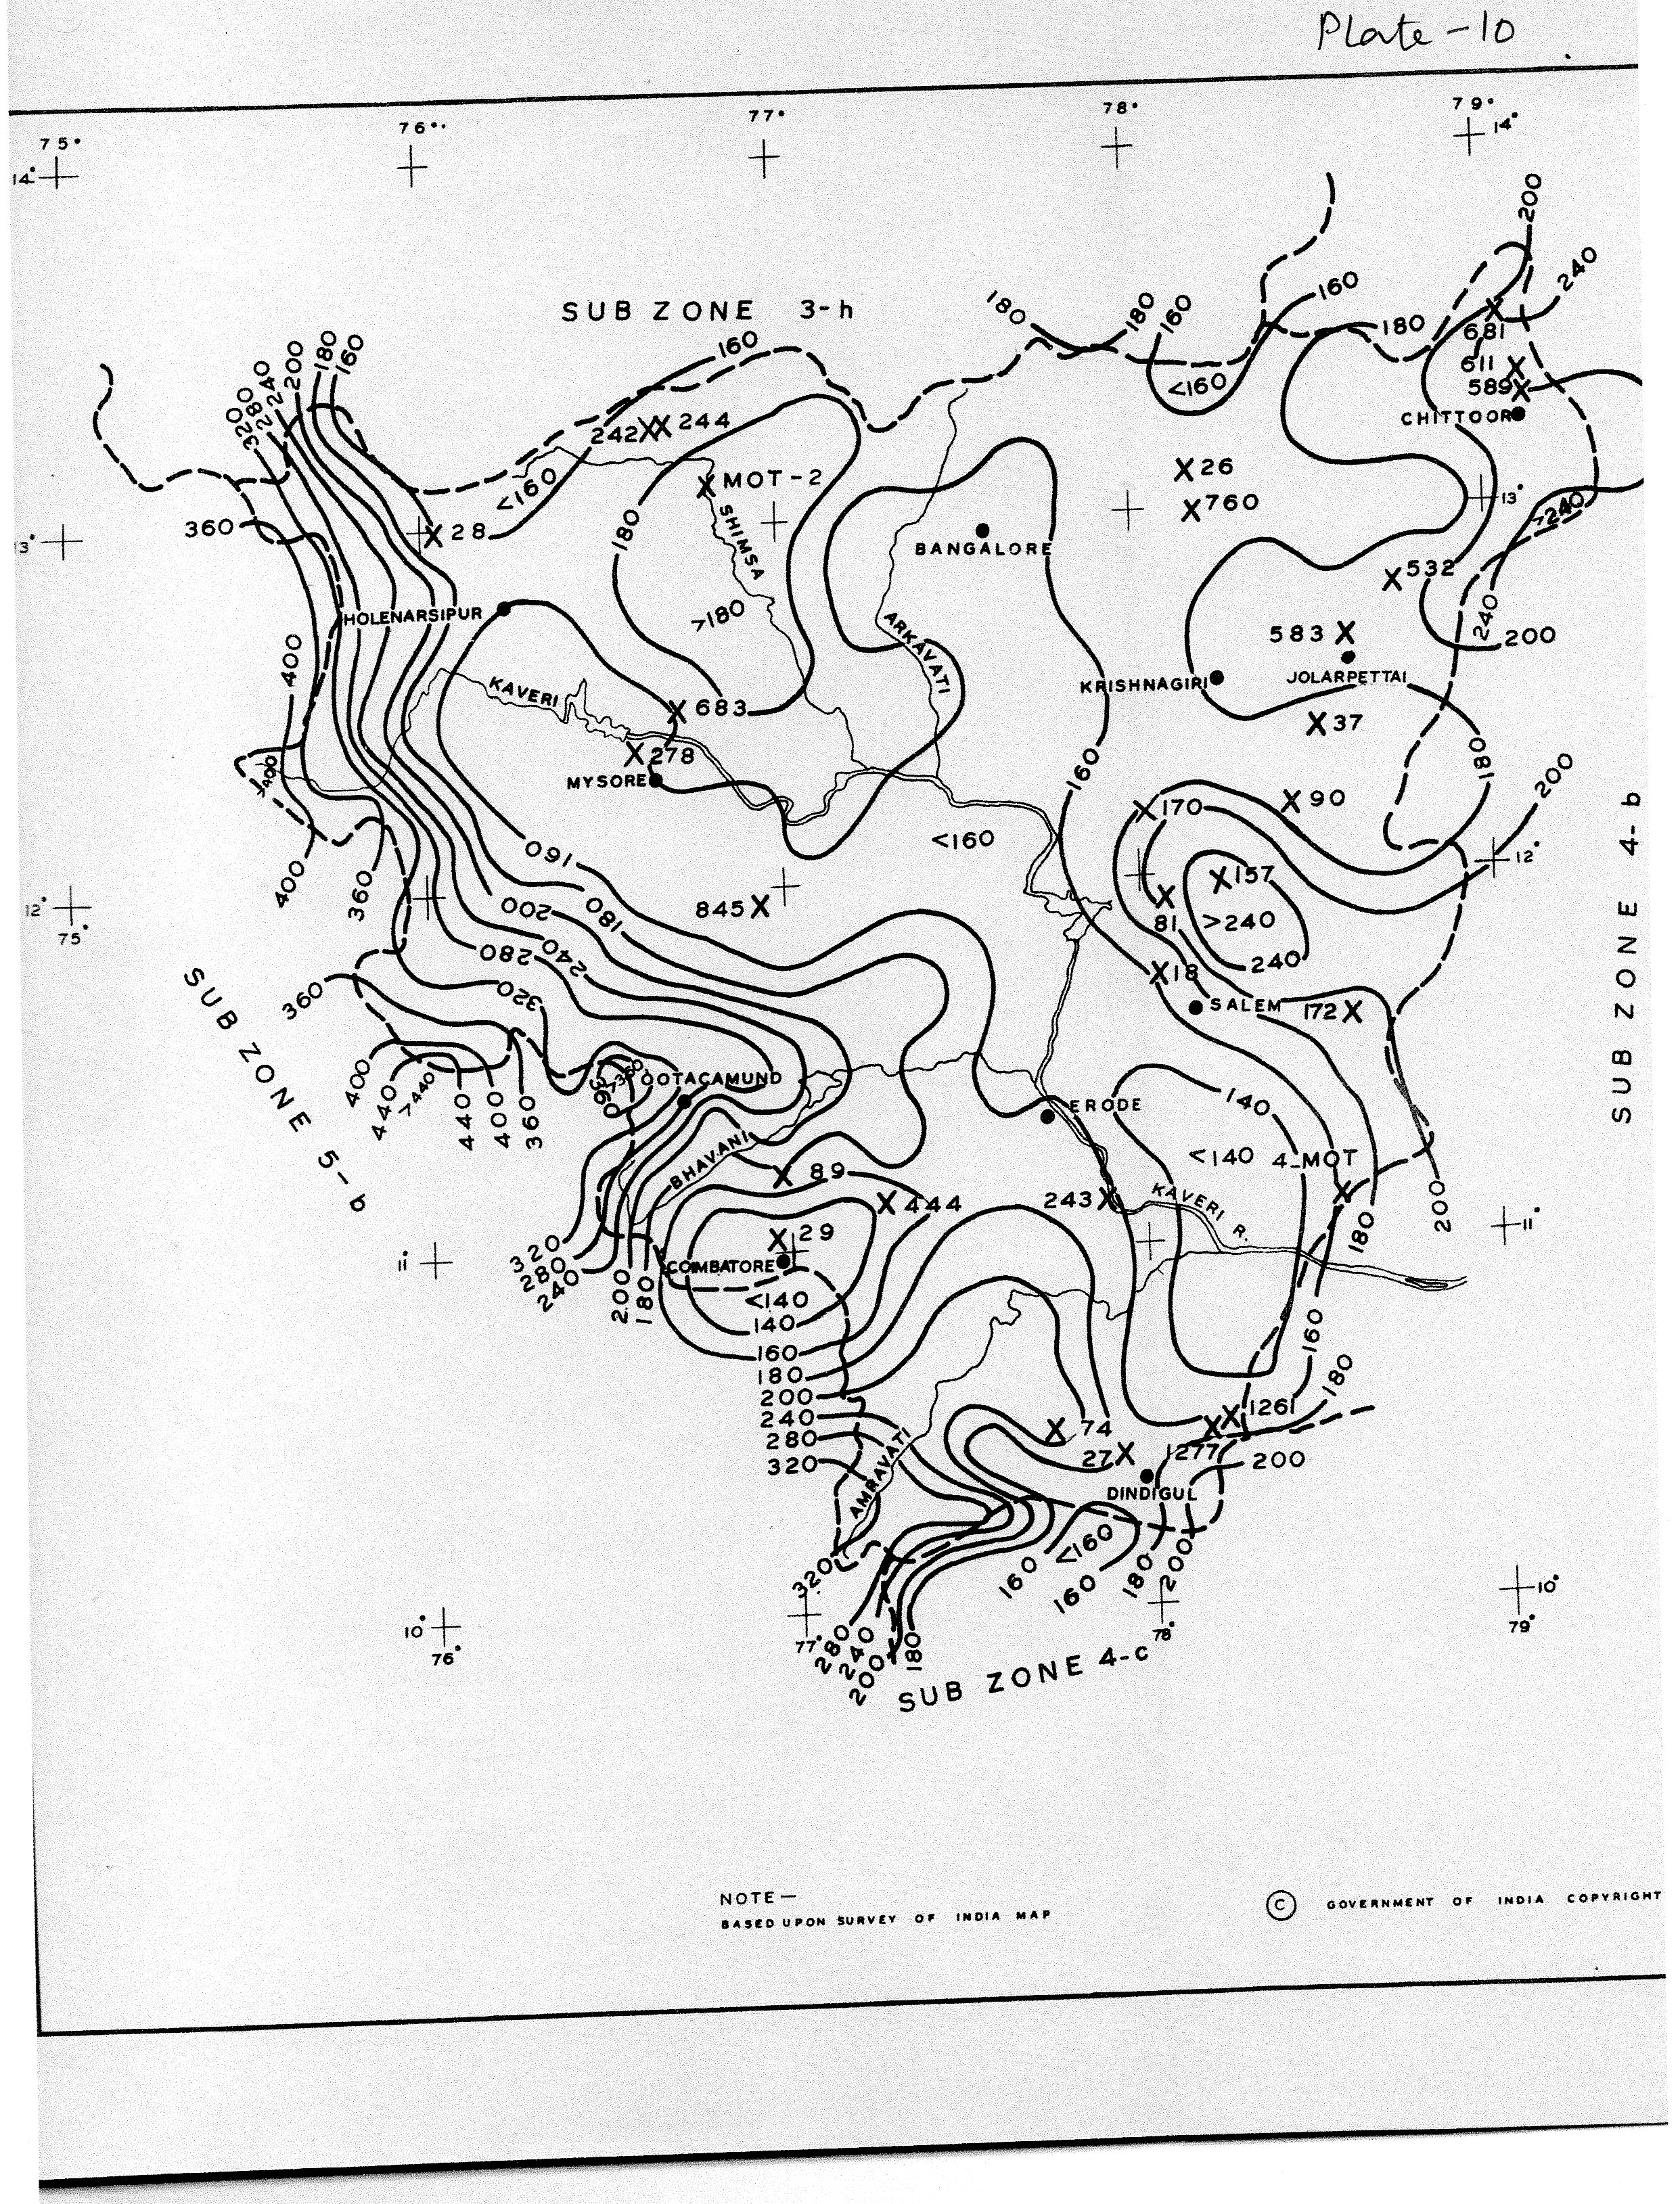
50 year 24 hour point rainfall (Value of R) (Ref Fig-1)

Slide 22
Values of X
S. No. | Description of the Catchment | Value of X
1. | Sandy Soil/Sandy loam/Arid areas | 0.249
2. | Alluvium/silt loam/coastal areas | 0.332
3. | Red soil/clayey loam/cultivated plains/tall crops/wooded areas | 0.415
4. | Black cotton clayey soil/lightly covered/plain & barren | 0.456
5. | Hilly soil/plateau and barren | 0.498

Slide 23
Values of F (Areal reduction factor)
Catchment area | Duration of Rainfall
(km²) | < 30 min | 30 to 60 min | 60 to 100 min
< 2.5 | 0.72 | 0.81 | 0.88
> 2.5 < 5.0 | 0.71 | 0.80 | 0.87
> 5.0 < 13.0 | 0.70 | 0.79 | 0.86
> 13.0 < 25.0 | 0.68 | 0.78 | 0.85

Slide 24
Method of working out Q50
Step-1: calculate time of concentration ( in hrs)
tc is time of concentration ( in hrs), It is the time taken by water to travel from most distant point on the periphery of catchment to the point of interest
L is Length of longest stream ( in kms) from source to bridge site
H = Height of farthest point above the point of interest along the river ( in meter) i.e. height of farthest point from bed level

Slide 25
Step-2: working out areal reduction factor (F) for given catchment area ( in sqkm) & value of tc
Step-3: working out Runoff coeff(C)
For given description of catchment and value of F & R
Step-4 : Calculation of 50 year rainfall intensity in mm/hr lasting for tc hr duration
= R50(tc) by referring to fig-4 of report
For tc hrs duration read from the report, ratio of 50 yr tc hrs rainfall / 50 year 24 hrs rainfall
R50(tc) = R50 (24 hr) rainfall x above ratio
I = R50(tc) / tc in hrs

Slide 26
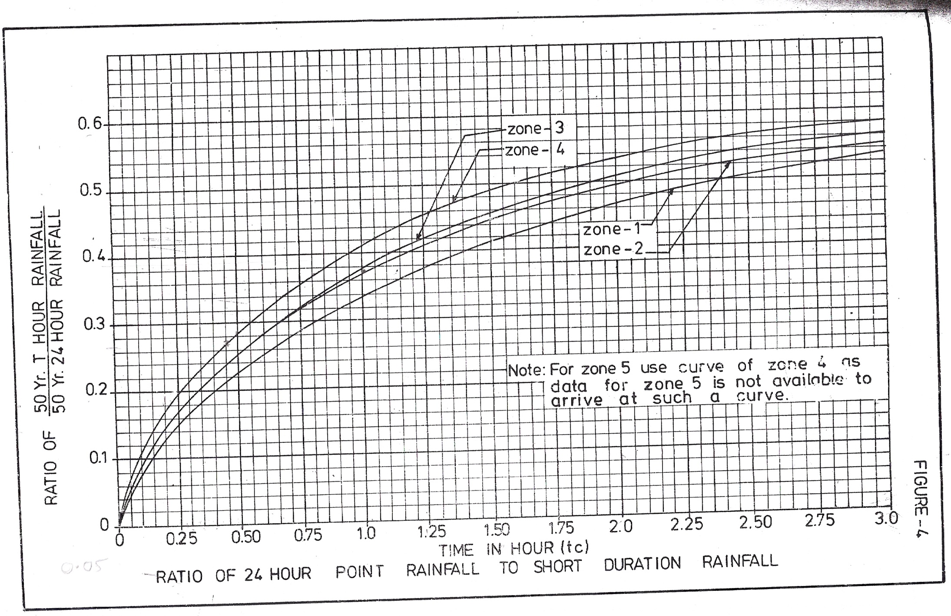
50 year t_{c} hour Rainfall (page 10-fig4)

Slide 27
Step-5 Now Q₅₀ = 0.278 C I₅₀ A
Where
Q50 is the design discharge with recurrence interval of 50 years in m³/s
C is the runoff coefficient
I50 = 50 year rainfall intensity lasting for tc hrs duration in mm/hrs
A = Catchment area in sq km

Slide 28
Sample calculations
Example: Working out Q50 for small catchments
1) A = 2.54 sqkm (Catchment area)
2) L = 2.50 km (Length of longest stream course from source to bridge site)
3) H = 67.25 m (Height of farthest point from bed level)
4) Description of catchment = Red soil
R50 - 24 hrs = 16 cms
Value of F = X
Run off coeff = Y
Ratio of 50 year tc hrs rainfall/ 50 year 24 hrs rainfall= Ref fig-4 of report

Slide 29
Estimation of design discharge by SUH
Steps involved (broadly) are:
Derivation of Synthetic unit hydrograph & plotting SUH
Estimation of design storm duration & intensity
Estimation of design loss-rate & base flow
Estimation of Rainfall excess units
Working out flood hydrograph

Slide 30
r
t
1 Cm
RAINFALL EXCESS
p
t
TYPICAL
UNIT
HYDROGRAPH
W
W
75
3
R75
Q
p
DISCHARGE IN m /s
W
50
W
R50
TB
TIME IN HOURS

Slide 32
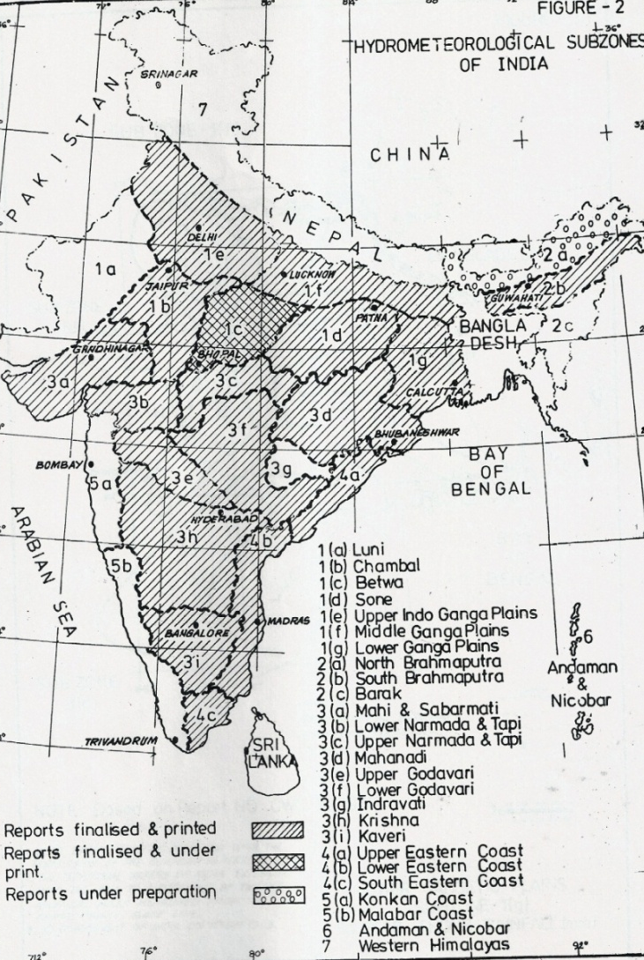
Hydro meteorological zones
Use of flood estimation reports :
The country has been divided into 7 hydro meteorological zones and 26 subzones .
Flood estimation reports have been published. (a joint work of CWC, RDSO, IMD, and MOST)

Slide 33
Flood estimation method for catchments
(25-2500 sqkm)
Detailed steps involved in working out flood discharge (Q50) based on SUH concept
1) Unit Hydrograph
2) 50 year -24 hrs Rain fall ( Plate-10 of the report)
3) Ratio for given storm duration (Fig-10 of the Report)
4) Areal reduction factor ( Table A-3 of the Report)
5) Time distribution of areal rainfall (Table A-02 of the Report)

Slide 34
Sample Example
i) Volume of runoff from 1 cm excess rainfall on catchment area A =
A x1000 x 1000 /100 m³
ii) Volume of direct run off from SUH = £Q x 60*60 m³
Therefore
£Q =A/0.36
Sum total of UH ordinates is equal to A / 0.36
A= 294 sqkm
L= 43 km
L_{c}= 22.72 kms
R50-24 hrs rain fall =17.5 cms
1) Ratio for 50 yr 7 hr rain fall duration = X
2) Reduction factor for areal rainfall = Y
3) Time distribution for rain fall = Z
4) Loss rate = 0.5 cm/hr
5) Base flow = 0.05 x A
6) Details of RL of river bed at diff locations

Slide 35
Catchment Parameters
5
AREA OF CATCHMENT -A
4
CG OF THE CATCHMENT
3
LENGTH OF LONGEST STREAM : L
L
Lc
LENGTH OF STREAM FROM NEAREST TO CG TO THE BRIDGE SITE – Lc
2
1
EQ. OR STASTICAL STREAM SLOPE- S

Slide 36
Design discharge for foundation (Qf) ( Para 4.4 S.S.C)
  To provide for an adequate margin of safety against an abnormal flood of magnitude higher than the design discharge (Q), the foundation, protection works and training works except free board shall be designed for higher flood discharge. The magnitude of this discharge shall be computed by increasing design discharge (Q) estimated according to clause 4.2, by the percentage indicated below.
  Catchment area Increase
  Up to 500 km² : 30%
  > 500 & upto 5000 km² : 30% - 20%
  > 5000 & upto 25000 km² : 20% - 10%
  > 25000 km² : Less than 10%

Slide 37
Various River Phases (Para 801)
  Upper Reaches (Mountainous)
  Sub-montane Reaches (Foot Hills)
  Quasi-Alluvial Reaches (Trough)
  Alluvial Reaches
  Tidal Reaches
Types of rivers
Hilly, sub-mountain, alluvial, coastal
Meandering, straight, braided
Aggrading, degrading, stable
Flashy, virgin

Slide 38
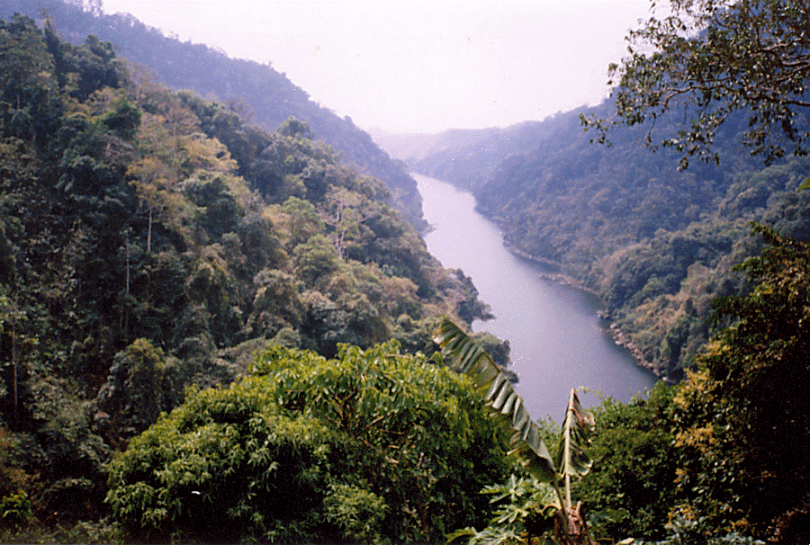
UPPER REACHES (Para 802) (Mountainous Rivers)
Narrow, Deep Cross Section, Steep Slope
Bed Material – Rock, Boulders, Gravel
Rise – Sudden and Flashy
Water with high concentration of sediment load
River channel in hills

Slide 39
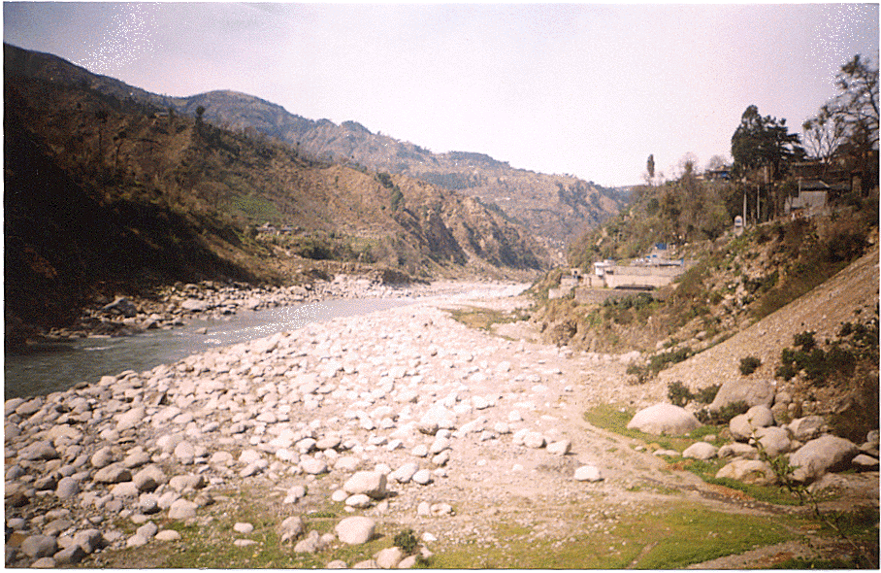
Sub-mountain river channel
Sub-montane Reaches (Para 803) (Foot Hills)
Bed slopes 1 in 50 to 1 in 500
Bed Material –Boulders, Gravel and sand
Floods – Sudden and Flashy : All these channels normally overflow during high floods and the river acquires very wide and shallow cross section. The rivers in this reach are prone to progressively raise their beds by sediment deposition. Such rivers are known as "Aggrading" type.

Slide 40
Quasi Alluvial reaches
Bed slopes 1 in 500 to 1 in 2500
Bed Material –Small size gravel and Medium Side
Channel–Generally well defined course
Alluvial Reaches (Para 805)
Bed slopes 1 in 2500 to 1 in 25000
River flows on flat Bed of Material Alluvium (sediment deposited by flowing water)
River Meanders in its Khadir ( a strip of low land with in which river meanders)
River Bed is normally stable

Slide 41
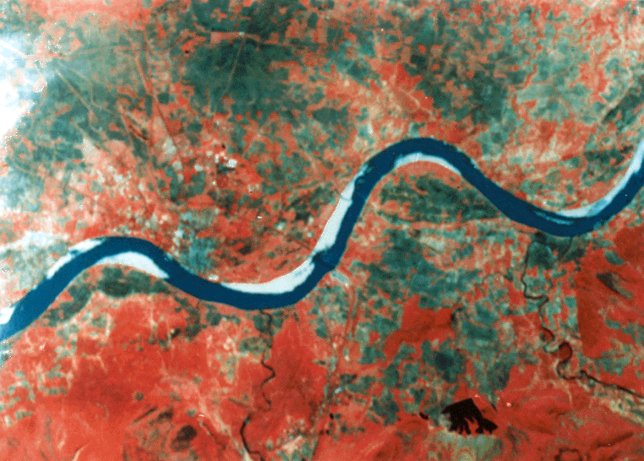
Meandering River Channel

Slide 42
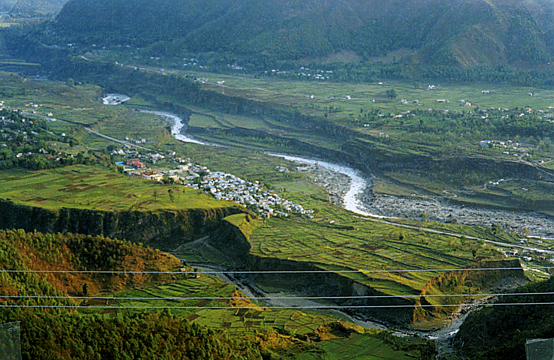
Meandering river

Slide 43
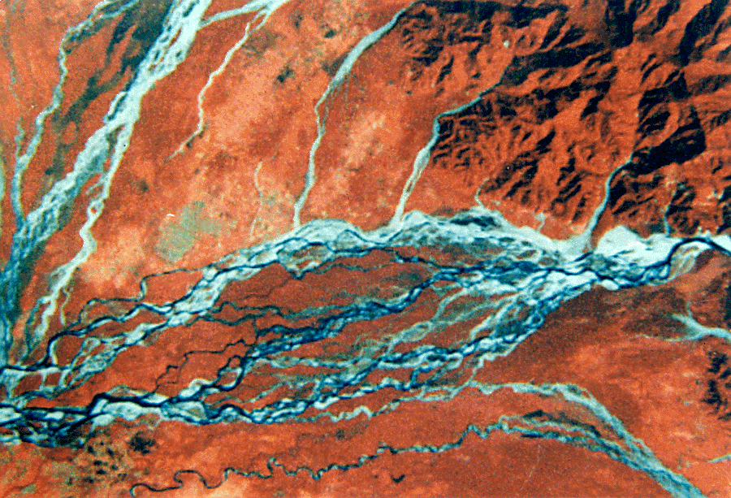
Braided River Channel
Island Type
When flow in river channel is insufficient to transport the eroded material,& gets deposited , thereby blocking the channel. Another channel then may be formed and in course of time river bed become a network of such channels with island in between. Such streams are called braided stream

Slide 44
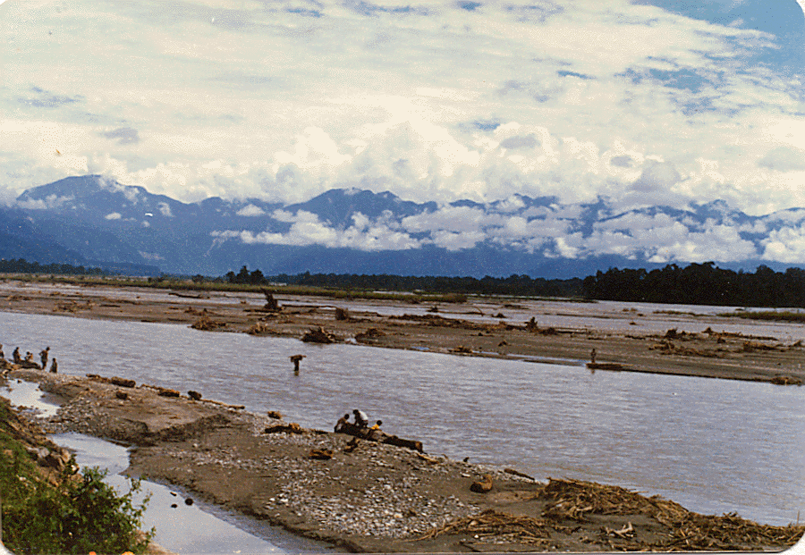
Island type braided channel

Slide 45
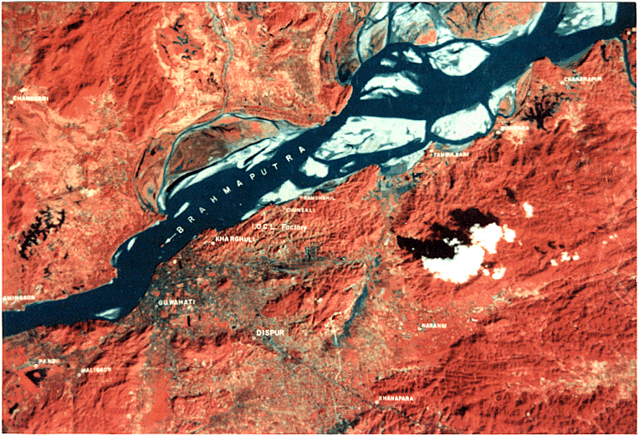
Straight Channel

Slide 46
Types of Rivers (Contd)
Aggrading: Rivers in this reach are prone to raise their beds by sediment deposition, due to reduction in velocity.
Degrading: lowering of bed by erosion due to higher velocity
Stable: No perceptible rise of lowering of river bed occurring over long periods
Virgin: They have no outfall in the sea nor do they join any other stream. Such rivers after traversing some distance loose all their water by percolation & evaporation

Slide 47
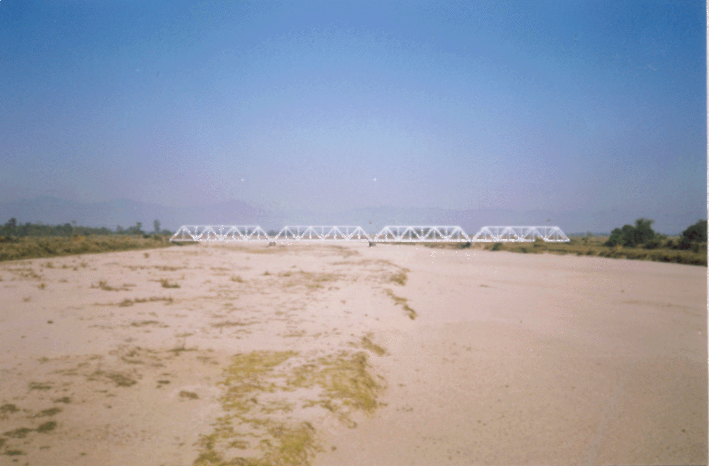
Aggrading river
Aggrading: Rivers in this reach are prone to raise their beds by sediment deposition, due to reduction in velocity.

Slide 48
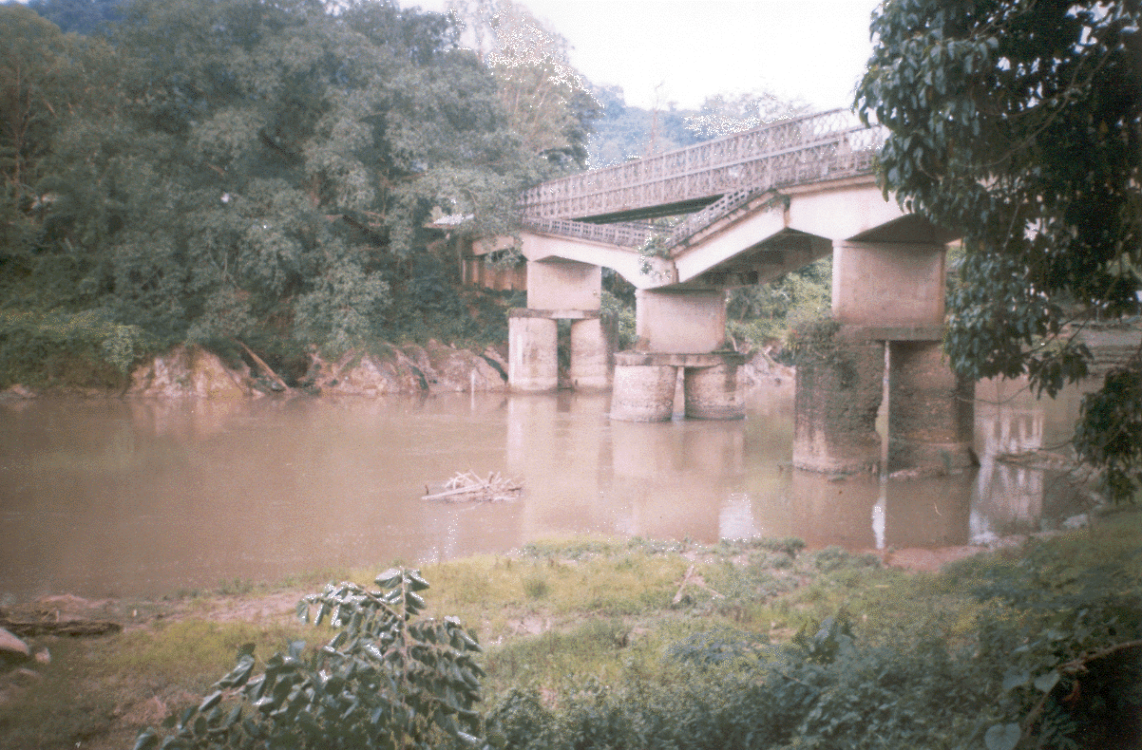
Degrading river
Sinking of pier
Degrading: lowering of bed by erosion due to higher velocity

Slide 49
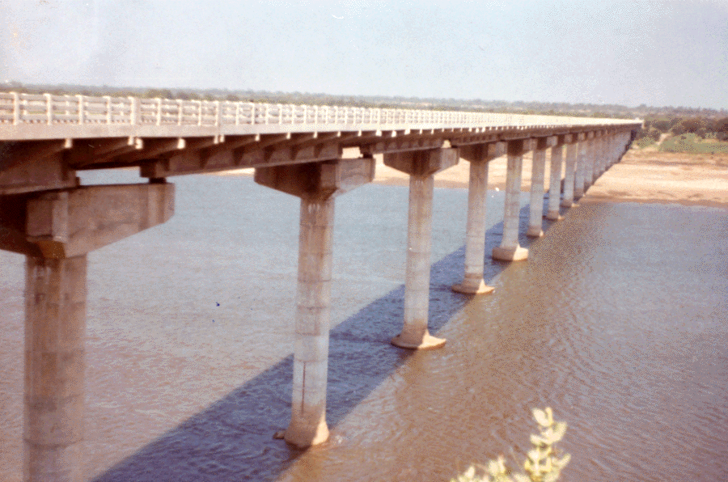
Stable river
Stable: No perceptible rise of lowering of river bed occurring over long periods

Slide 50
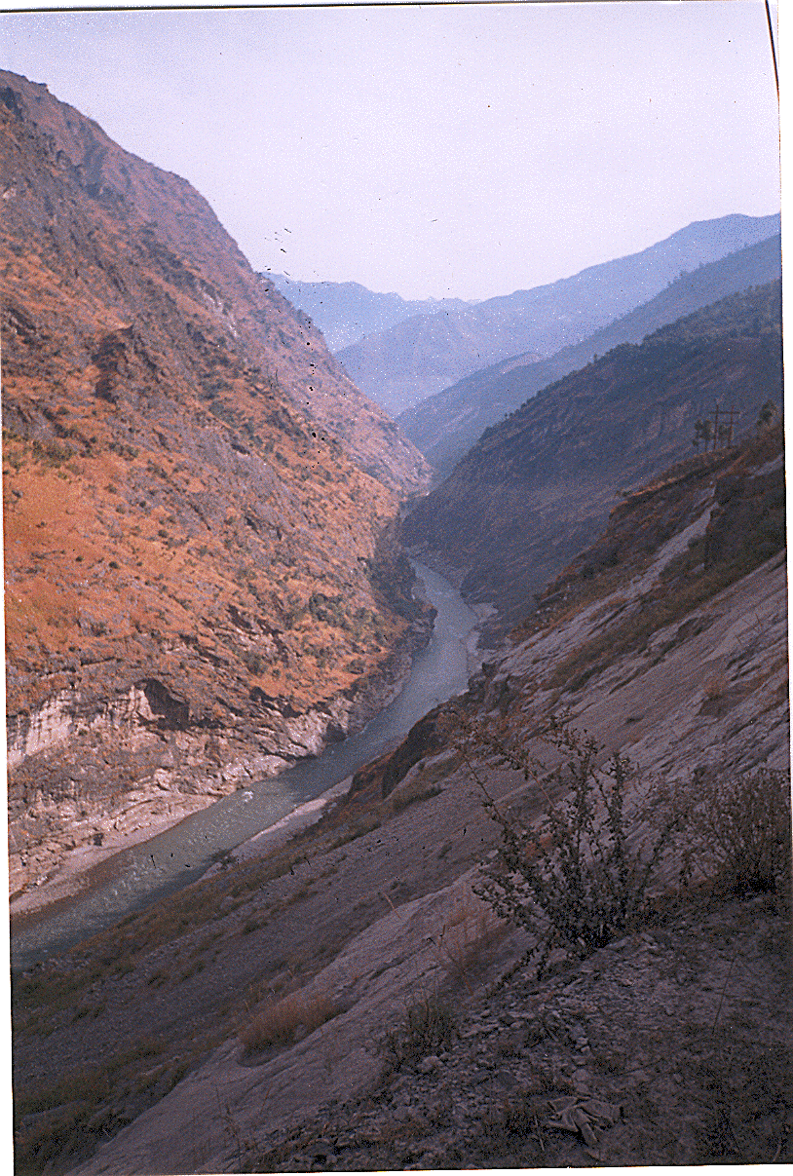
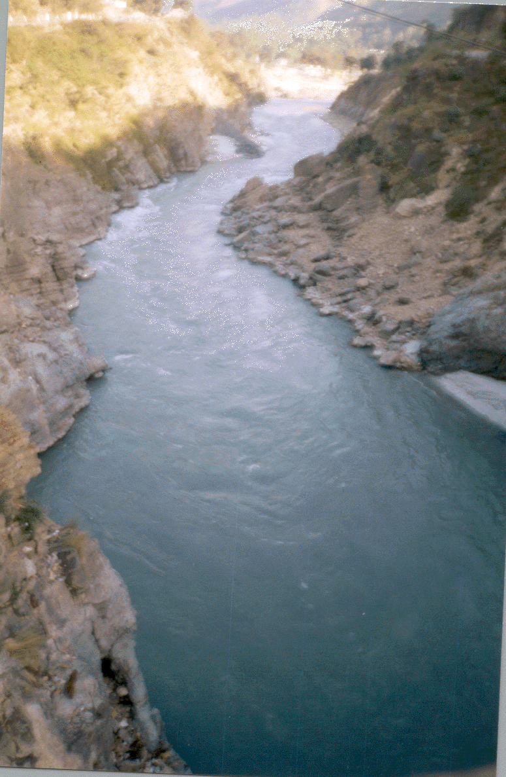
Flashy Rivers in the hills

Slide 51
Design of Water ways (S.C.C Para 4.5)
Para 4.5.1 In the case of a river which flows between stable high banks and which has the whole of the bank-to-bank width functioning actively in a flood of magnitude Q
the waterway provided shall be practically equal to the width of water spread between the stable banks for such discharge.
If, however, a river spills over its banks and the depth of spill is appreciable
the waterway shall be suitably increased beyond the bank-to-bank width in order to carry the spill discharge as well.

Slide 52
Para 4.5.2 In the case of a river having a comparatively wide and shallow section, with the active channel in flood confined only to a portion of the full width from bank to bank,
constriction of the natural waterway would normally be desirable from both hydraulic and cost considerations.
A thorough study of both these factors shall be made before determining the waterway for such a bridge.
Para 4.5.3 For river with alluvial beds and sustained floods the waterway shall normally be equal to width given by Lacey’s formula :
Pw = 1.811 C √Q ⇒ 4.83 (Q)^{0.5}
Pw = Wetted perimeter in metres which can be taken as the effective width of waterway in case of large streams
Q = design discharge in cum/sec
C = a coefficient normally equal to 2.67, but which may vary from 2.5 to 3.5 according to local conditions depending upon bed slope and bed material.

Slide 53
Para 4.5.4 If the river is of a flashy nature i.e. the rise and fall of flood is sudden or the bed material is not alluvial and does not submit readily to the scouring effect of the flood,
Lacey’s regime width formula as given in clause 4.5.3 will not apply
Para 4.5.5 In case of rivers in sub-montane stage, where the bed slopes are steep and the bed material may range from heavy boulders to gravel, it is not possible to lay down rigid rules regarding constriction of water way. Any constriction in such cases shall be governed largely by :
The configuration of active channels
The Cost involved in diversion & training of these channels
The cost of guide bunds which will need much heavier protection than the guide bunds of alluvial rivers.
Each case shall be examined on merits from both hydraulic & economic consideration and best possible solution choosen

Slide 54
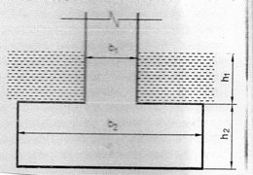
Para 4.5.6 In case of a bridge having one or more piers, the width of waterway obtained from procedure outlined in clause 4.5.3 to 4.5.5 above shall be increased by twice the sum of the weighted mean submerged width of all the piers including footings for wells to arrive at the total width of waterway to be provided between the ends of the bridge; where such increase is not made, the same shall be applied as a deduction from the total width of waterway actually provided to arrive at the effective width.
Para 4.5.6.1 If the width of the pier is b1, for a height h1, and b2 for height h2 in the submerged portion of the pier having a total height h1 + h2, the weighted mean submerged width is given by the expression.
bmean = h1 b1+h2 b2/(h1 + h2)

Slide 55
Para 4.5.7 For gauge conversion and doubling works, where there is no history of past incidents of over flow/washout/excessive scour etc during last 50 years
the water way of existing bridge may be retained after taking measures for safety as considered necessary by Chief Engineer In charge.
For locations where there is history of past incidents of over-flow/washout/excessive scour,
the waterway has to be re-assessed based on the freshly estimated design discharge using clause 4.3.1 to 4.3.4.
For locations, where existing bridges are less than 50 years old and there is no past history of incidents of over flow/washout/excessive scour etc,
the water way may be judiciously decided after calculation of the design discharge and keeping in view the water way of existing bridges on adjacent locations on the same river.

Slide 56
Para 4.5.8 For rebuilding of bridge,
waterway shall be determined keeping in view the design discharge as worked out from clause 4.3
Para 4.5.9 For strengthening existing bridges by jacketing etc, a reduction in waterway area as per the limits specified below may be allowed by the Chief Bridge Engineer provided that there has been no history of past incidents of overflow/washout/excessive scour etc and that measures for safety as considered necessary by the Field Engineer and approved by CBE are taken.
SN | SPAN OF BRIDGE | REDUCTION IN WATERWAY AREA ALLOWED AS %AGE OF EXISTING WATERWAY.
1 | Upto and including 3.05 m | 20%
2 | 3.05m to 9.12m including | Varying linearly from 20% to 10%
3 | Greater than 9.12m | 10%
Further reduction in the area shall be subject to CRS sanction and submission of detailed calculation of waterways etc. Where the clearances are not available, the bridge should be rebuilt

Slide 57
Depth of Scour (Para 4.6 S.S.C)
Para 4.6.1 The probable max depth of scour for design of foundations and training & protection works shall be estimated considering local condition
Para 4.6.2 Wherever feasible & especially for flashy rivers and with beds having boulders or gravels
sounding for purpose of determining the depth of scour shall be taken in the vicinity of site proposed for the bridge. Such sounding are best taken during or immediately after flood
In calculating design depth of scour allowance shall be made in the observed depth for increased scour due to
i)The Design discharge being greater than observed discharge
ii) Increase velocity due to constriction
iii)Increase in scour in the proximity of pier/abutments

Slide 58
Para 4.6.3 In the case of natural channels flowing in alluvial beds where the width of waterway provided is not less than Lacey’s regime width,
the normal depth of Scour (D) below the foundation design discharge (Q_{f}) level may be estimated from Lacey’s formulas as indicated below
D = 0.473 (Q_{f}/f)^{1/3}
where D is depth in metres Q_{f} is in cumecs and
f is Lacey’s silt factor for representative sample of bed material obtained from scour zone.
Para 4.6.4 Where due to constriction of waterway, the width is less than Lacey’s regime width for Q or where it is narrow and deep as in the case of incised rivers and has sandy bed, the normal depth of scour may be estimated by the following formula :
D = 1.338 (^{q}f²/f)^{1/3}
Where qf is the discharge intensity in cubic metre per second per metre width and ‘f’ is silt factor as defined in clause 4.6.3.

Slide 59
Para 4.6.6 The depth calculated (vide clause 4.6.3 and 4.6.4 above) shall be increased as indicated below, to obtain maximum depth of scour for design of foundations, protection works and training works :
Nature of the river | Depth of scour
In a straight reach | 1.25 D
At the moderate bend conditions e.g. Along apron of guide bund | 1.5 D
At a severe bend | 1.75 D
At a right angle bend or at nose of piers | 2.0 D
In severe swirls e.g. Against mole head of a guide bund | 2.5 to 2.75 D
Para 4.6.5 The silt factor ‘f’ shall be determined for representative samples of bed material collected from scour zone using the formula :
f = 1.76 √m
Where m is weighted mean diameter of the bed material particles in mm

Slide 60
The Values for ‘f’ for different types of bed material, commonly met with are given below:
Type of bed material | Weighted mean dia of particle (mm) | Value of ‘f’
(i) Coarse silt | 0.04 | 0.35
(ii) Fine sand | 0.08 0.15 | 0.50 0.68
(iii) Medium sand | 0.3 0.5 | 0.96 1.24
(iv) Coarse sand | 0.7 1.0 2.0 | 1.47 1.76 2.49
D1/D2 ⇒ (f2/f1)^{(1/3)} ⇒ (m2/m1)^{(1/2)} ^{x (1/3)} ⇒ (m2/m1)^{1/6}
D1/D2 = (2/0.04) ^{1/6} = 1.92
Para 4.6.7 In case of clayey beds, wherever possible, maximum depth of scour shall be assessed from actual observations

Slide 61
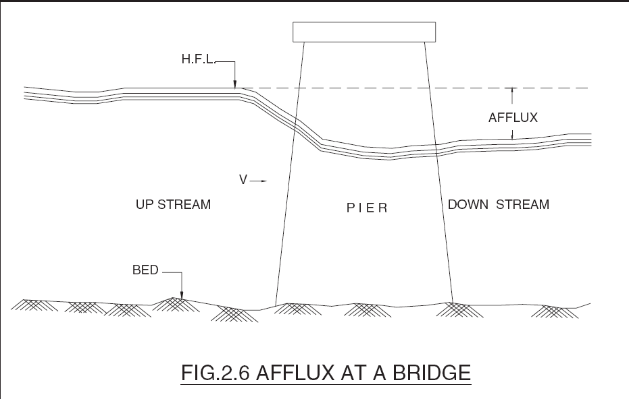
AFFLUX (Para 4.7 of sub structure code )
Afflux (h): The rise in water level upstream of bridge as a result of obstruction to the natural flow caused by the construction of the bridge & its approaches
For streams with non-erodible beds, the afflux may be worked out by Molesworth formula given below :
h = {V²/17.88 + 0.01524} x {(A/a) ²- 1}
Back
Where, h = afflux in metres
V = Velocity in un-obstructed stream in m/sec
A = Un obstructed sectional area of the river in m²
a= Sectional area of the river at obstruction in m².
Para 4.7.2 In case of rivers with erodible beds, full afflux as calculated by the formula may not occur
Clearance & free board

Slide 62
Clearance ( C ) ( Para 4.8 S.S.C)
The vertical distance between the water level corresponding to design discharge Q including afflux and the point on the bridge super structure where the clearance is required to be measured
Para 4.8.1 The Minimum clearance for bridges excluding arch bridges, pipe culvert and Box culverts
Discharge (cumecs) | Vertical clearance
0 - 30 | 600 mm
31-300 | 600 mm – 1200 mm
301 - 3000 | 1500 mm
Above 3000 | 1800 mm
Note: Syphons, pipe and box culverts are designed as pressure conduits, therefore no clearances are considered necessary for these structures ( Ref: Para 312(3) Bridge manual).

Slide 63
Clearance (Contd)
  Para 4.8.2 In the case of arch Bridge, Minimum clearance measured to crown shall be
Span of Arch | Clearance
Less than 4 m | Rise or 1200 mm
4.0 to 7.0 m | 2/3 rise or 1500mm
7.1 to 20.0 m | 2/3 rise or 1800 mm
Above 20.0 m | 2/3 rise
  Para 4.8.3 Clearance can be relaxed by CE/CBE provided:
    Adoption of prescribed clearance results in heavy expenditure and /or serious difficulties

Slide 64
    The clearance can be safely reduced to
  The relaxation shall be personally exercised by PCE/CBE, due consideration being given to past history of bridge.
  Para 4.8.4 while executing works other than rebuilding, retain existing clearance
  Para 4.8.5 where a tendency has been observed for the bed level of stream to rise , clearance shall be provided taking this factor into account.
Discharge (cum) | Clearance (mm)
Less than 3 | 300
3 to 30 | 300 - 400 (Pro-rata)
31 to 300 | 400 - 1200 (Pro-rata)

Slide 65
Free Board (Para 4.9 S.S.C)
The vertical distance between the water level corresponding to design discharge (Q) including afflux(h) and the formation level of its approach bank / top level of guide bank.
  Minimum free Board from water level of design discharge to formation level of Railway embankment or top of guide bund shall be one meter
  suitably increased if heavy wave action is expected
  CE/CBE can relax Free Board in spl. circumstances as indicated below:-
Discharge (cumecs) | Min free board (mm)
Less than 3 | 600 mm
3 to 30 | 750 mm
More than 30 | No relaxation

Slide 66
References:
1. Sub Structure Code -2013
2. RBF-16 report published by RDSO
3. Flood estimation report for kaveri basin sub zone – 3(i)
Field work
To see calculations for Q50 for small/ medium size catchments for new line / doubling projects in design / construction office
Plotting catchment for a bridge from topo sheet & Working out catchment properties
Thank You

